Slide 1
Presentazione del corso
M. Zazzi

Slide 5
dbARCA main steps
2002 – Collection of clinical data started to complement virological data
2004 – ARCA web site and db launched
2005 – ARCA opened to research proposals
2014 – Major system revision to include Hepatitis data and turn to complete Electronic Medical Recording system

Slide 6
dbARCA objectives
Building treatment response models and treatment decision tools
On-line Electronic Medical Recording system
HIV, HBV, HCV genotype interpretation via the AntiViroScan algorithm, curated by the University of Siena
Repository for HIV, HBV, HCV research proposals requiring a large amount of data or a specific uncommon patient population
Middle layer between local clinics and national/international public programs, particularly focusing on response to antiviral therapy or molecular epidemiology
www.dbarca.net → Obiettivi

Slide 7
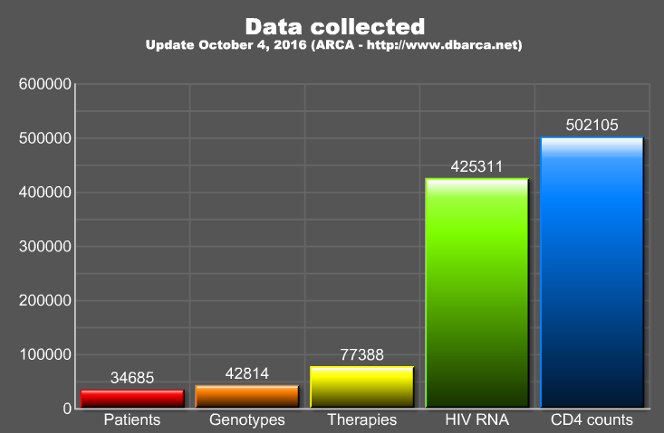
Number of records in the main HIV tables
www.dbarca.net → Interroga il db in tempo reale

Slide 8
dbARCA governance
Statute
Scientific Board (voluntary based)
One Reference Person per center, appointed by the unit Director
Key contact person with ARCA
Duration established by the center itself
One Authorship Delegate per center, appointed by the Reference Person and Director
Duration established by the center itself
Directly inserted by the center itself in the private area of the web site
www.dbarca.net → Statuto e regolamenti

Slide 9
dbARCA governance
Statute
Scientific Board (voluntary based)
One Authorship Delegate, appointed by the Reference Person and Director
Duration established by the center itself
Directly inserted by the center itself in the private area of the web site
One Reference Person per center, appointed by the unit Director
Key contact person with ARCA
Duration established by the center itself
www.dbarca.net → Statuto e regolamenti

Slide 10
From data to publication
Idea
ARCA Board
ARCA centers
Queries & Tables
Data analysis
Paper
From any ARCA member or non-member
Is the proposal sound and ethical?
Are my data available for this study?
Sent from the ARCA IT staff to the proposal P.I.
Done by the proposal P.I. and statisticians
P.I. and statisticians, authorship according to ARCA rules
7-10 days
7-10 days
2-4 weeks
www.dbarca.net → Attiva uno studio

Slide 11
From data to publication Authorship rules
P.I. plus up to 4 collaborators
Up to 15 total authors adding the ARCA Authorship Delegates (subject to editorial policy limits)
Included in authorship
Not included in authorship but credits saved for future studies
Study dataset
Individual DB’s
www.dbarca.net → Statuto e regolamenti
(web site -> Statuto e regolamenti)

Slide 12
From data to publication
Publication system launched in 2005 (HIV)
110 data requests including 18 from abroad
Only 4 not approved
107 publications
78 Conference papers
36 Papers
Low paper/conference ratio (0.5)
Publications (public area) and requests (private area) tracking available on the web site
www.dbarca.net → Pubblicazioni
(web site -> Pubblicazioni; web site -> Richieste)

Slide 13
Generating the appropriate datasets for clinically relevant questions

Slide 14
Generating the appropriate datasets for clinically relevant questions
Biomedical domain
IT & data management domain

Slide 15
Generating the appropriate datasets for clinically relevant questions
Biomedical domain
IT & data management domain
Learn the basics of data structure
Avoid professional lingo
Learn the basics of the biomedical topic
Avoid professional lingo

Slide 16
Generating the appropriate datasets for clinically relevant questions
Biomedical domain
IT & data management domain
Create and nurture a generation of "middleware" professionals
Increase accuracy of data collection
Minimize misunderstandings in generating datasets
Expedite the process from data to product

Slide 17
The spirit and format of ARCA Mentor School
Integration between the biomed and IT domains
Cooperation & networking
Yearly event
Mostly hands-on format
Working group with biomedical and IT tutor
Queries are followed up remotely after the on-site course
Suggestions for improvement always welcome!

Slide 18
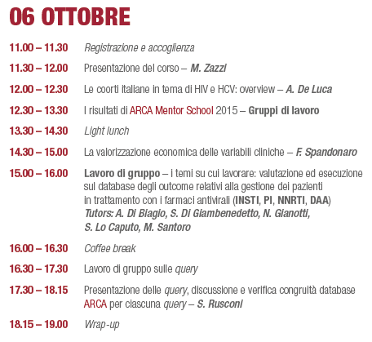

Slide 19
