Slide 1
Virological and immunological efficacy of regimen including MVC
Dott.ssa Barbara Rossetti
UOC Malattie Infettive
AOU Senese

Slide 2
Background
Dual therapy including maraviroc in virologically suppressed patients and in naive patients were associated with good tolerability but was virologically inferior to 3-drug ART
GUSTA, MARCH, MODERN
Concordance between coreceptor tropism predicted through V3-loop DNA sequence and RNA sequence of HIV-1 gp120 to predict virological response to CCR5 antagonists
Meini 2013, Svicher 2013, Ferrer P 2013
Impact on T cell activation?
Vitiello 2012, Asmuth 2012, Taiwo 2013, Nozza 2015

Slide 3
Objectives
To evaluate virological and immunological response in a population of treatment-experienced patients with HIV-1 RNA <50 cps/ml switched to maraviroc including regimen
To identify determinants of virological response

Slide 4
Methods
Treatments in ARCA including maraviroc, with any other drug (2009-2015)
HIV-1 RNA <50 copies/ml
Baseline HIV-1 RNA available <12 weeks
Univariable and multivariable logistic and linear regression to evaluate the determinants of virological response
Paired sample T-test for CD4 gain at 24, 48 and 96 weeks

Slide 5
Data source (n=191)

Slide 7
Data legend

Slide 9
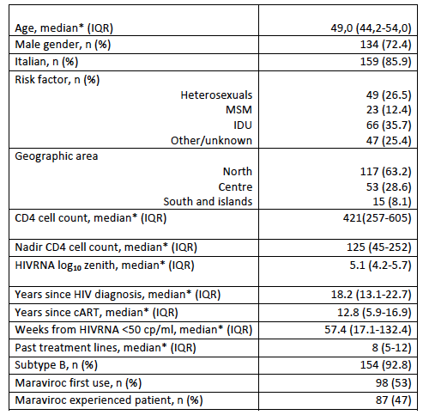
Characteristics of the patients at baseline (n=185 treatments from 152 patients)
Values ​​are expressed as n (%) except for the * median (IQR)

Slide 10
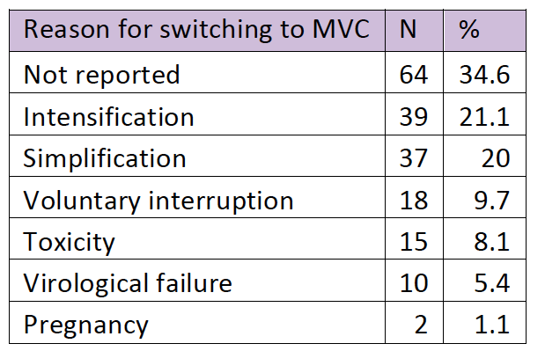
Reasons for switching to MVC including regimen (n=185)

Slide 11
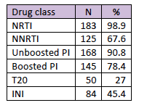
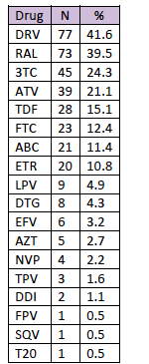
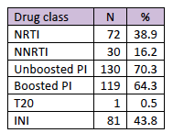
ART drug
Previous drug class used
Concomitant drug
GSS score (Rega)
74 (40%) patients were on dual therapy, of which more frequent regimen were DRV/r+MVC was 29 (39%)
Concomitant drug class

Slide 12
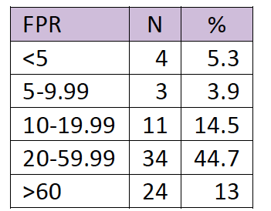
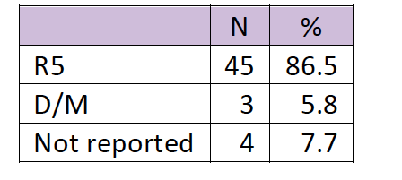
Viral tropism available <12 week in 128/185 (69%), of which 114 (89%) were R5 with at least 1 between geno2pheno or phenotypic test
76 geno2pheno test
50 on HIV-1 RNA
26 on HIV-1 DNA
52 phenotypic test on HIV-1 RNA

Slide 13
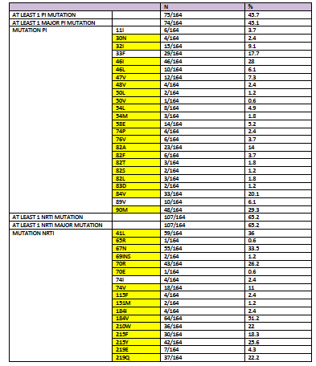
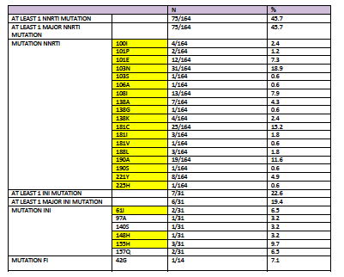
Major resistance mutation by IAS 2015
Note: in yellow major mutation by IAS list 2015

Slide 14
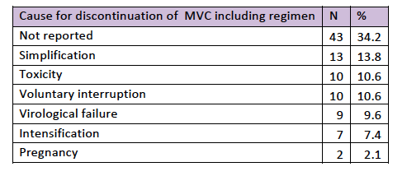
At the time of this query, 91 (49.2%) treatments were still ongoing

Slide 15
Virological response to MVC including regimen
 | N | %
24 week (still on MVC) | 153/185 | 82.7%
HIV-1 RNA <50 cps/ml after 24 week | 92/103 | 89%
48 week (still on MVC) | 139/185 | 75.1%
HIV-1 RNA <50 cps/ml after 48 week | 98/103 | 95%
96 week (still on MVC) | 105/185 | 56.7%
HIV-1 RNA <50 cps/ml after 96 week | 77/84 | 91.6%

Slide 16
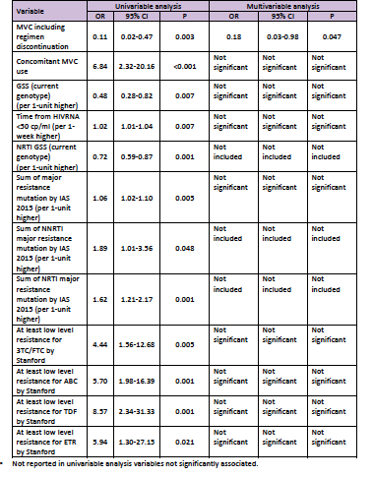
Predictors of virological response to MVC including regimen at 24 weeks

Slide 17
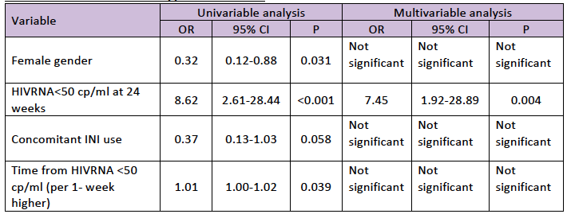
Predictors of virological response to MVC including regimen at 48 weeks
*Not reported in univariable analysis variables not significantly associated.

Slide 18
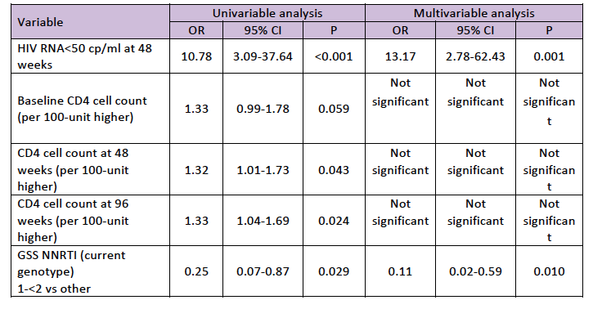
Predictors of virological response to MVC including regimen at 96 weeks
*Not reported in univariable analysis variables not significantly associated

Slide 19
Immunological response

Slide 20
Conclusion
Intensification and simplification are the leading cause of switch to maraviroc including regimen after virosuppression
High rate of dual therapy including maraviroc
Good immunological restoration on treatment with maraviroc
Need of implementation recording data

Slide 21
Thank you for your attention

